Slide 1



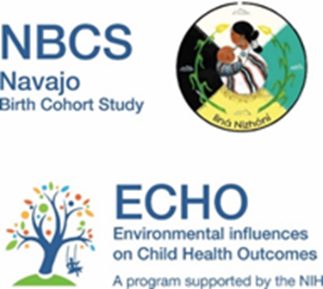

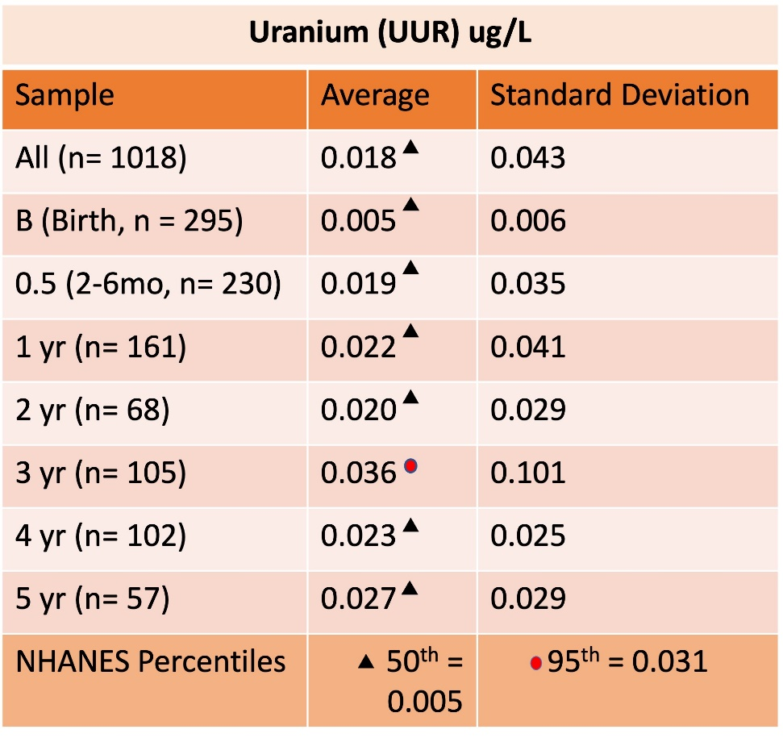
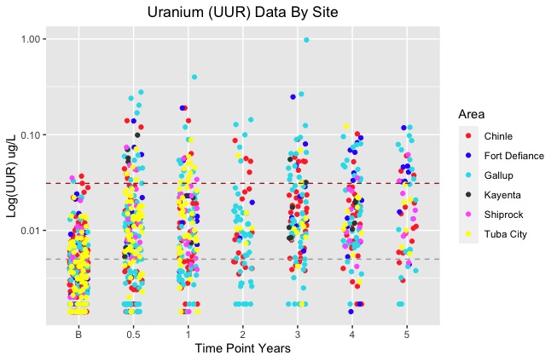
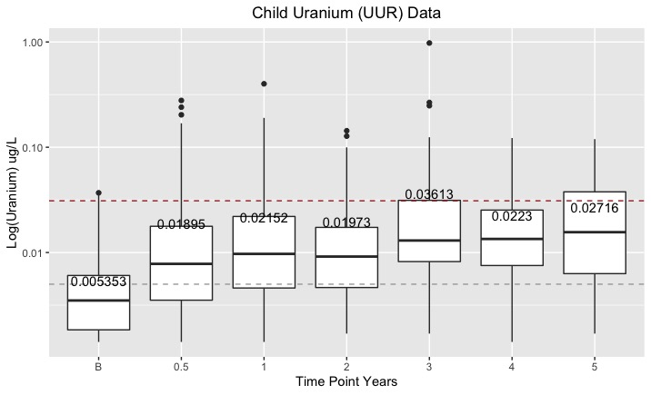
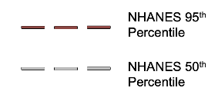
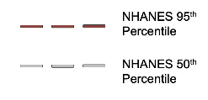
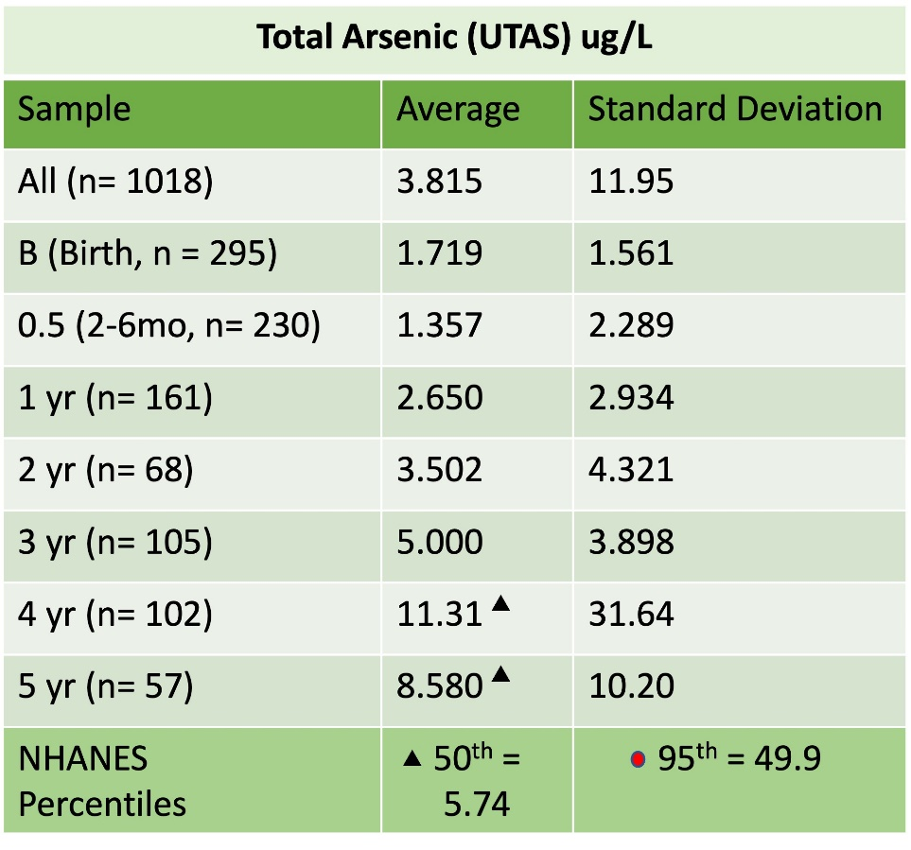
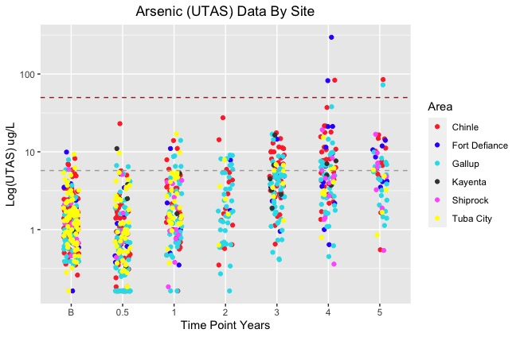
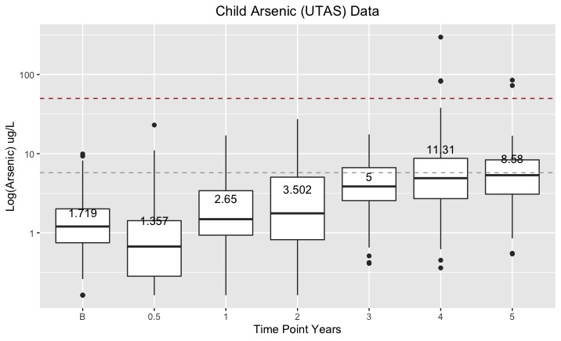
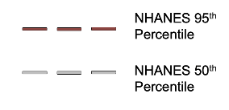
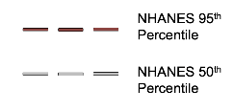
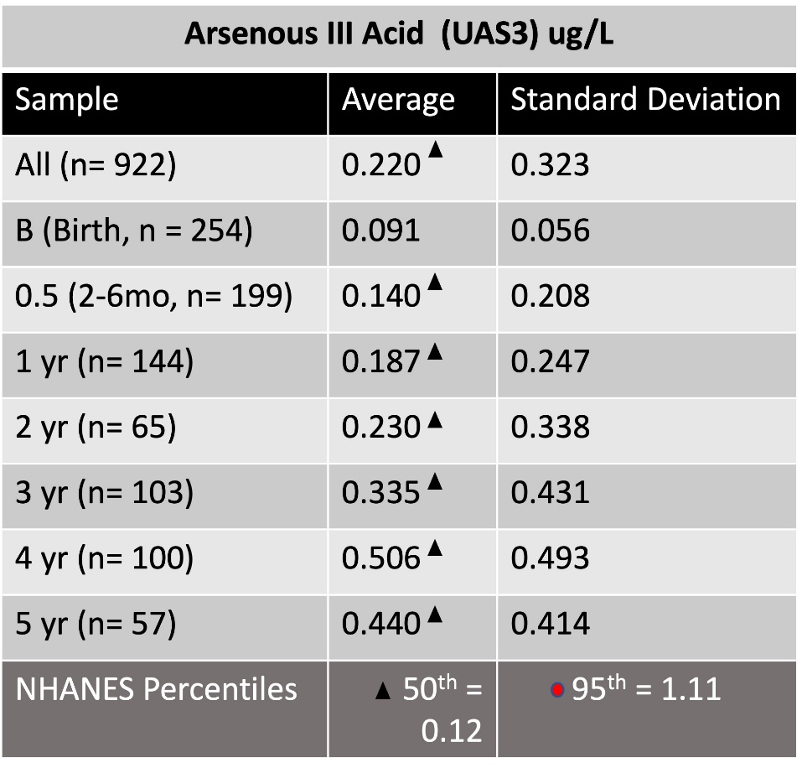
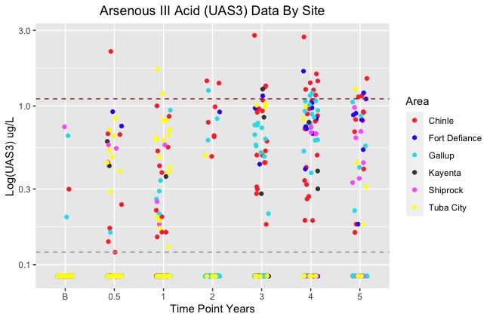
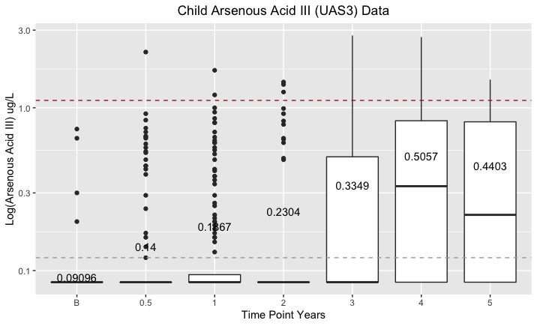
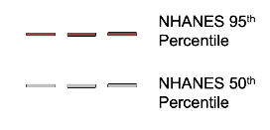
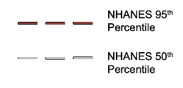
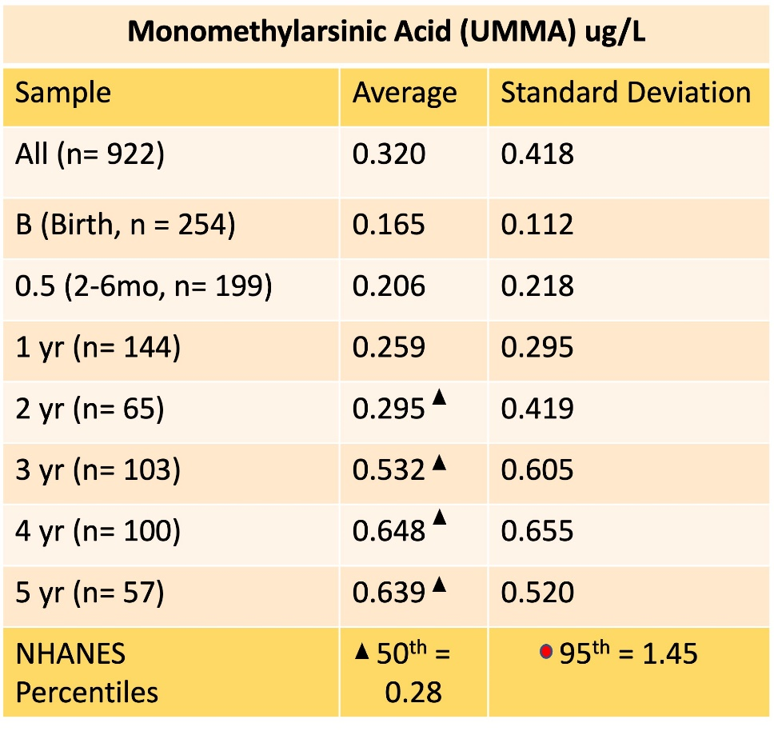
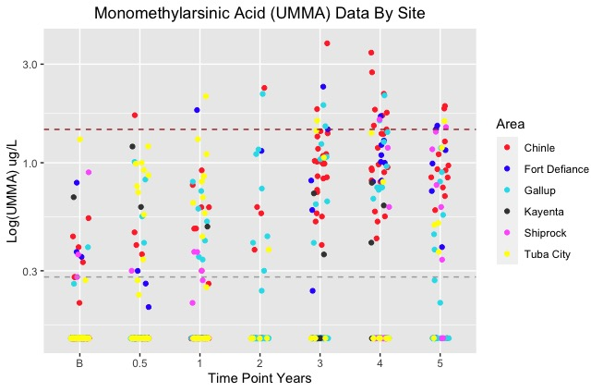
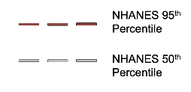
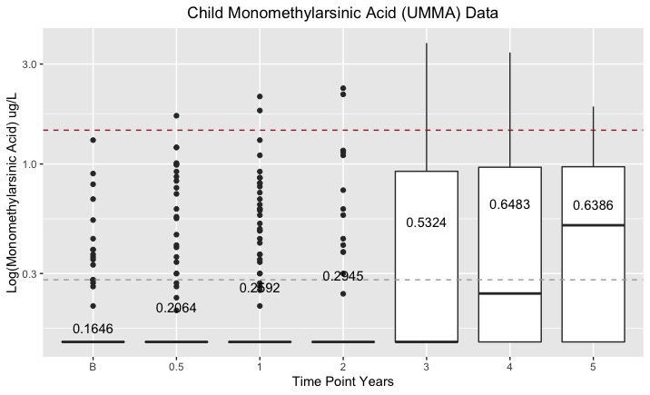
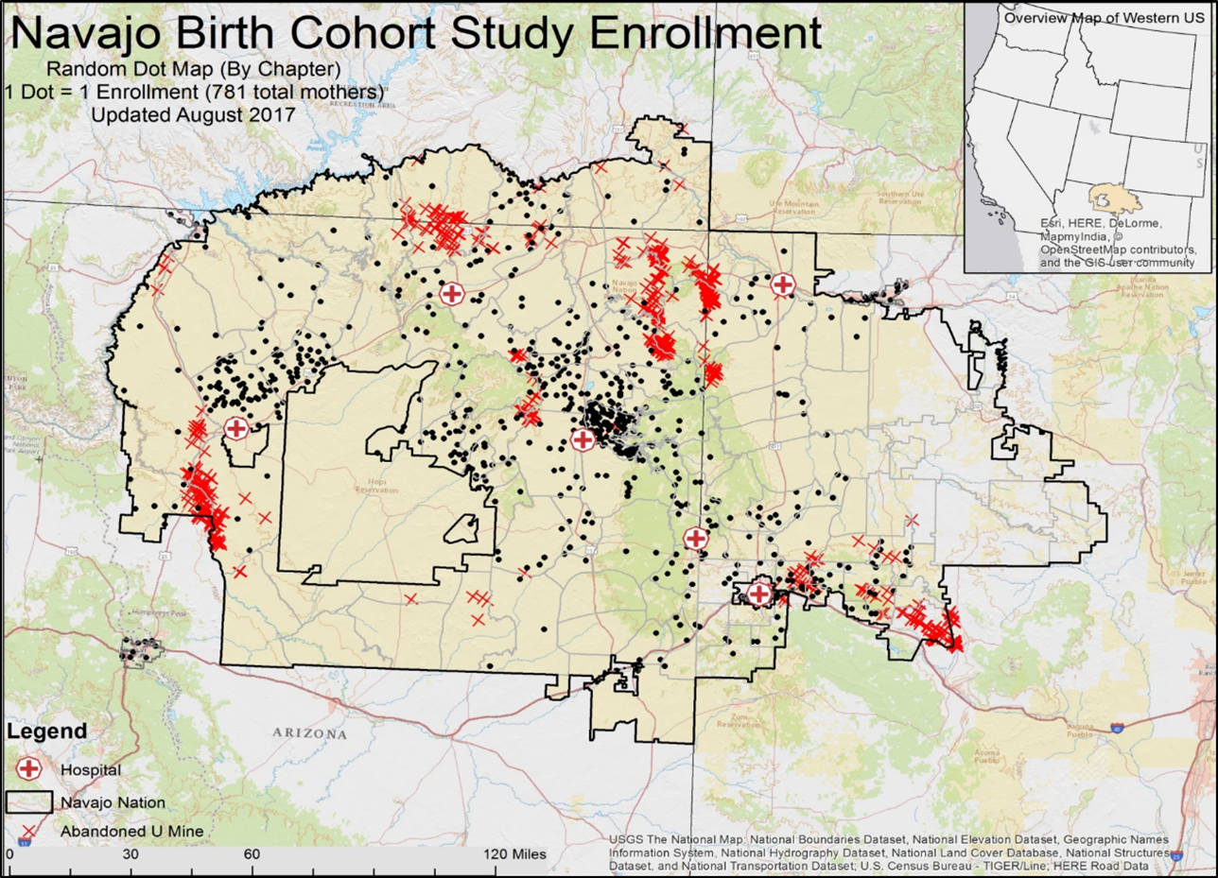
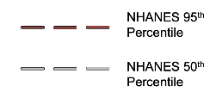
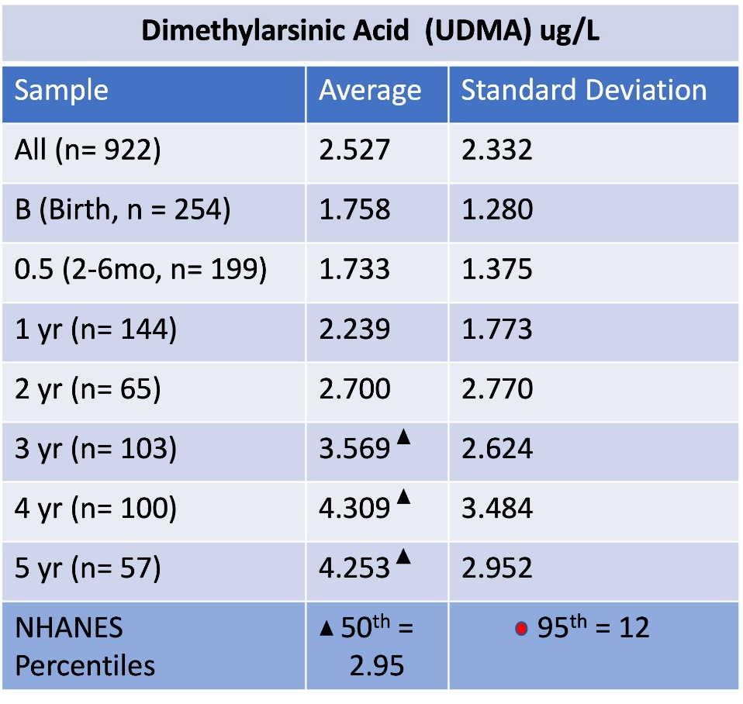
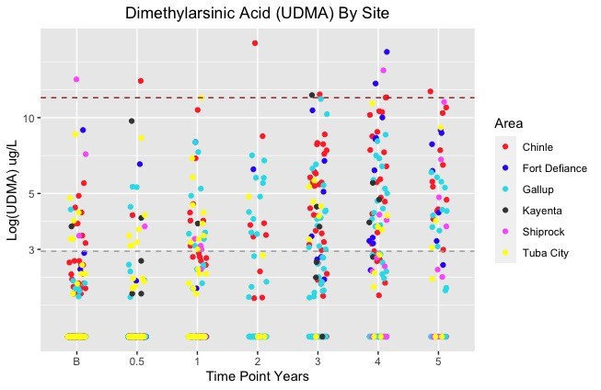
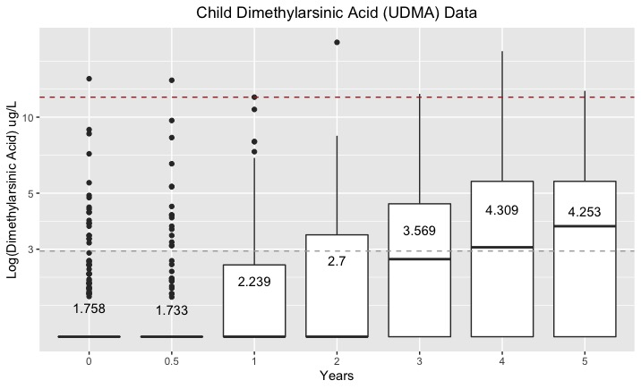
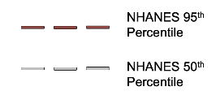
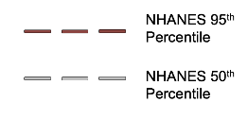
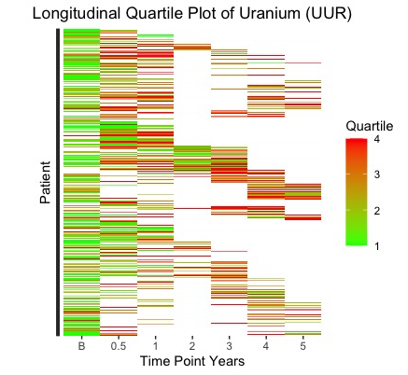
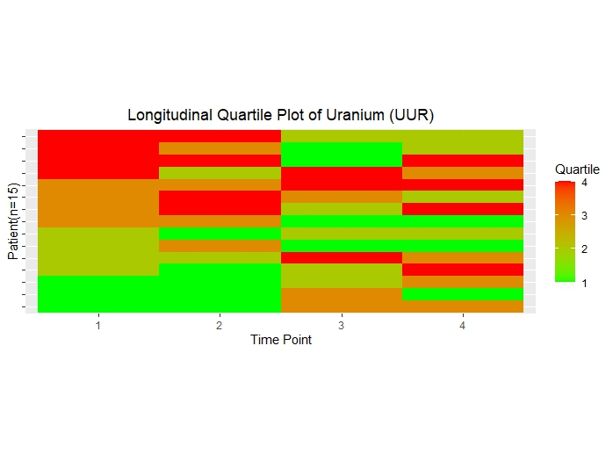
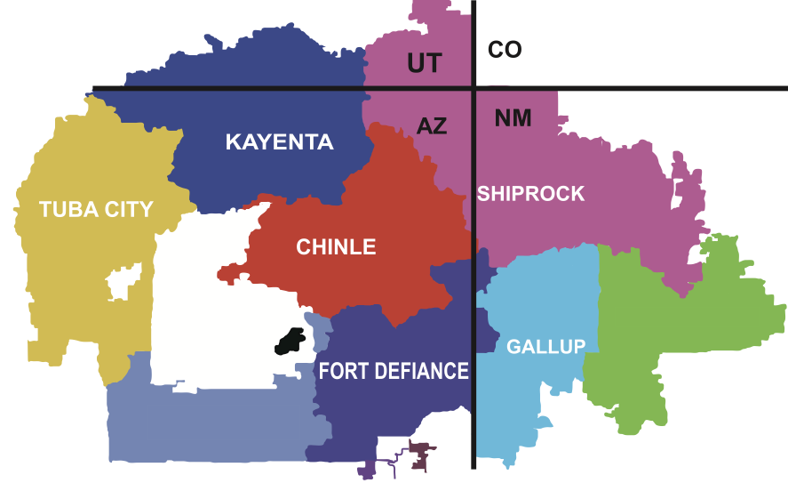

Longitudinal Study of Carcinogenic Metals in Navajo Children from the Navajo Birth Cohort Study
Rayna Vue¹,Tamara Daniels¹ , Li Luo² , Elena O’Donald^{1,} Qeturah Anderson³, Nikki Begay³, Priscilla Begay¹, Frienda Clay¹, Valsitta Curley¹,Latisha Joseph¹, Yolanda Joseph³, Lynda Lasiloo⁴, Amber Morgan³, Kathleen Nez³,Sandy Ramone⁴, Wileen Smith¹, Kayden Tallsalt¹, Roxanne Thompson¹, Doris Tsinnijinnie¹, Shasity Tsosie¹, Maria Welch⁴ , Johnnye Lewis¹ , Debra MacKenzie¹
1 - University of New Mexico Health Sciences Center, Community Environmental Health Program, College of Pharmacy, Albuquerque, NM
2-Department of Internal Medicine and UNM Comprehensive Cancer Center, University of NM, Albuquerque, NM
3-Navajo Department of Health, CHR program, Navajo Nation
4-Southwest Research and Information Center, Albuquerque, New Mexico
ABSTRACT
RESULTS
There are over 500 abandoned uranium mines across the Navajo Nation, exposing communities to environmental metals known to act as carcinogens. Exposure to carcinogens at early-life stages have been shown to increase the likelihood of developing cancer later on^{3,4}. Children are at a developmental stage in life where they may be more susceptible to effects later in life⁴. The current study identified and analyzed metal exposures in longitudinal samples from 556 children enrolled in the Navajo Birth Cohort Study (NBCS). Concentrations of uranium (UUR), total arsenic (UTAS), dimethylarsinic acid (UDMA), monomethylarsinic acid (UMMA), and arsenous III acid (UAS3) were assessed longitudinally between birth to 5 years of age. The goals of this study were to (i) compare metal concentration levels in children to the national average found in adults, (ii) identify the changes in metal concentrations overtime, (iii) identify the overall distribution of metal concentration, and iv) determine patterns of exposure (i.e. chronic or acute) in longitudinal samples. Findings demonstrate early life exposures to metals known to contribute to cancer incidence. Overall trends show increasing metal concentrations of uranium, total arsenic, inorganic arsenic (arsenous III acid) and arsenic metabolites (dimethylarsinic and monomethylarsinic acid), in children over the time period tested. It is especially concerning that the measured metal concentrations are at or approaching average adult concentrations as reported by the National Health and Examination Survey (NHANES). These results can guide future health initiatives in Navajo communities as well as to initiate research to better understand exposure sources and identify mitigation approaches to reduce early life exposures to toxic metals.
The averages of UUR across all time points are over the 50th percentile reported for adults by NHANES.
The NBCS average for barium, lead, and mercury exceed the NHANES 50th percentile at several time periods ( ).
CONCLUSIONS
Concentrations of UTAS were lower than the 50th percentile, except in samples from 4 and 5 yr olds.
Uranium, arsenic, dimethylarsinic acid, monomethylarsinic acid, arsenous III acid, barium, lead, and mercury from children in the Navajo Birth Cohort study reach concentrations similar to those reported in adults by NHANES, at or before the age of 5.
Compared to arsenic and its metabolites, uranium concentrations were higher than national averages, with some children having concentrations exceeding the 95th percentile for adults across the US.
Exposures appear to be across all participating sites across Navajo Nation.
Many participants have at least one time point in which their concentrations of uranium were in the upper quartile, indicating most children in the NBCS are experiencing sporadic exposures to uranium during early childhood.
INTRODUCTION
A mining boom in the late 1940s has left over 500 abandoned uranium mines throughout the Navajo Nation.
Despite their closure, abandoned mines and mine waste sites continue to emit toxic metals into the air, water, and food which can be ingested or inhaled by the community.
Exposure to these metals have been linked to an increased risk of developing cancer or other adverse health conditions.
Children may be more sensitive to environmental exposures during development, increasing their susceptibility for developing cancer in adulthood.
Average and median values of UAS3 are considerably far apart throughout the 0.5 to 3 time points, demonstrating a skewed distribution.
STUDY PURPOSE
DISCUSSION
Assess metal exposures over time in children from birth to 5 years of age.
Determine the distribution of metal concentrations within samples over time.
Compare metal concentrations in children from the NBCS with NHANES adult samples.
DMA and MMA are metabolites of arsenic that have been shown to have toxicity of their own.
Average and median values of UMMA and UDMA have a skewed distribution with averages exceeding NHANES 50% for adult values.
Exposure to uranium has been linked to health effects involving the kidneys and respiratory system.
Exposure to arsenic is associated with increasing risk of developing tumors in bladder, lungs, kidneys, and liver.
With exposures beginning in childhood, there may be increased risk for development of cancer other adverse health consequences later in life in children who live in proximity to abandoned uranium mines and mine waste sites.
FUTURE DIRECTIONS
Determine what factors contribute to exposures.
Living in proximity to mine waste, dietary sources such as food/water
Identify initiatives to reduce exposure.
Conduct research with broader time range.
Map of participant enrollment by chapter in relation to abandoned Uranium mines
To examine patterns of exposure over time, concentrations were categorized by quartile and plotted by participant.
While there appear to be no consistent patterns of exposure, many participants have at least one time point in which their concentrations were in the upper quartile, indicating that most of the children in the NBCS are experiencing sporadic uranium exposures during early childhood.
REFERENCES
METHODOLOGY
1. Hoover J.H., Erdei E., Begay D., Gonzales M.; NBCS Study Team, Jarrett J.M., Cheng PY, Lewis J.(2020). Exposure to uranium and co-occurring metals among pregnant Navajo women. Environ Res. 2020 Nov;190:109943.
2. Navajo Epidemiology Center. (2018). Cancer Among Navajo 2005-2013. Navajo Epidemiology Center, Navajo Department of Health.
3. Norman, R. E., Ryan, A., Grant, K., Sitas, F., & Scott, J. G. (2014). Environmental contributions to childhood cancers. J Environ Immunol Toxicol, 2(2), 86-98.
4. Perlroth N.H., Castelo Branco C.W. (2017). Current knowledge of environmental exposure in children during the sensitive developmental periods. J Pediatr, 93(1):17-27.
5. RStudio Team (2020). RStudio: Integrated Development for R. RStudio, PBC, Boston, MA URL http://www.rstudio.com/.
Data sourced from children enrolled in NBCS and compared to average adult samples from National Health and Nutrition Examination Survey (NHANES).
Samples collected from 556 participants from 6 sites at 7 different time points.
2
5
ACKNOWLEDGEMENTS
Plot includes participants who had data from at least four time points from birth to 5 years of age. Plot is sorted based on quartile of exposure concentration at the earliest collected time point.
  We also acknowledge all of the former members of the Navajo Birth Cohort Team who have participated in data collection and study activities related to this work.
  This research was developed in part under cited research awards (below) to the University of New Mexico. Metals analysis were performed by the CDC Division of Laboratory Sciences. This content not been formally reviewed by the funding agencies. The views expressed are solely those of the speakers and do not necessarily reflect those of the agencies. The funders do not endorse any products or commercial services mentioned in this presentation.
  The Navajo Birth Cohort Study - NIH OD UH3OD023344. CDC U01 TS 000135. The presented data are solely the responsibility of the authors and do not necessarily represent the official views of the NIH, Centers for Disease Control and Prevention, or the Department of Health and Human Services.
  All human research reported here are monitored and approved by the UNM IRB and the Navajo Nation Human Research Review Board.
Plot includes all participants. Not all participants have data at each time point.
Notes:
Median higher than 50th percentile for uranium
Uranium mined on Navajo Nation over a period of ~40 years
Despite closure of mines, environmental risk persists
Poor efforts to remediate abandoned mines
Exposure to metals from mines in environment linked to variety of health issues
Exposure occurs via inhalation and ingestion
Several metals are known to cause cancer.
Children may be more sensitive to chemicals during development increasing susceptibility in developing cancer in adulthood.
A mining boom in the late 1940s has left several abandoned uranium mines throughout the Navajo Nation.
Despite their closure, mines have emitted toxic metals into the air, water, and food to be ingested or inhaled by the community.
Exposure to these meals have been linked to an increased risk of developing health risks such as cancer.
Children may be more sensitive to chemicals during development increasing susceptibility in developing cancer in adulthood.
Legacy of uranium mining on the Navajo nation has left communities exposed to environmental toxicants in the form of metals.
Navajo Epidemiology Center. (2018). Cancer Among Navajo 2005-2013. Navajo Epidemiology Center, Navajo Department of Health.
RStudio Team (2020). RStudio: Integrated Development for R. RStudio, PBC, Boston, MA URL http://www.rstudio.com/.
Hoover J.H., Erdei E., Begay D., Gonzales M.; NBCS Study Team, Jarrett J.M., Cheng PY, Lewis J.(2020). Exposure to uranium and co-occurring metals among pregnant Navajo women. Environ Res. 2020 Nov;190:109943.
Norman, R. E., Ryan, A., Grant, K., Sitas, F., & Scott, J. G. (2014). Environmental contributions to childhood cancers. J Environ Immunol Toxicol, 2(2), 86-98.
Perlroth NH, Castelo Branco CW. Current knowledge of environmental exposure in children during the sensitive developmental periods. J Pediatr (Rio J). 2017 Jan-Feb;93(1):17-27.
I’d like to thank my mentors Debra MacKenzie and Tamara Anderson for all their guidance and support during my research. Special thanks to the financial support from the Navajo Birth Cohort Study, Undergraduate Network Pipeline, and Cancer Research – Scholarship and Training in Population Sciences Program.
Column of metals
Relation to national norms (Show through bold, colors, etc.)
Combine means and STD +-
Make authors specific for SOT!

